Slide 1
MSc Project
(CMP060L050S)
Viva- Presentation
Analysing Machine Learning Methods for Predicting Flood Risk Using Historical Rainfall and River Observation Data
Student Name: Nathish Moorthy
Supervisor Name: Mr. Muhammad Rehan Usman

Slide 2
Outline
context
problematic statement
objectives
methodology
project management
literature review
Machine Learning Model
Flood Risk Prediction System
Contributions
Conclusion & Future Work

Slide 3
Context
Floods are also one of the most common and destructive natural calamities, which lead to serious social, economic and environmental losses [1].
Floods have been difficult to predict due to climate variability and rising intensity of rainfall.
The historical data of rainfalls and rivers observations are useful in determining the trends of flooding.
Machine learning supports the effective analysis of complex datasets to help in the correct risk of floods forecast and disaster awareness.
Notes:
Speaker Notes: Floods are among the worst natural disasters that have damage millions of people, and the calamity has had a harmful impact on infrastructure, agriculture, and livelihoods. Floods are becoming more frequent and harder to predict precisely due to the growing variability in climate. Machine learning can be used to predict flood risks by examining historical data of rainfall and river observation to uncover hide trends. The research will contribute to making timely decisions and disaster preparedness by predicting the disaster using data.

Slide 4
Problem Statement - WHY
Flooding has severe effects on life, property, infrastructure and basic public services, especially in the flood level areas like India.
Floods are caused by a complex interaction of various environmental and hydrological conditions, which makes their prediction difficult [2].
Conventional hydrological models tend to need large quantities of measurements and catchment details.
Machine learning: The data-driven methodology to compare predictive models and enhance flood-risk classification with the same experimental conditions.
Notes:
Speaker Notes: Predicting floods has been a problem because the occurrence of floods is related to the relationship between rainfall, river discharge, water levels, elevation and other environmental conditions. Conventional hydrological models are also very demanding about the amount of measurements that must be done and they may not be easily generalised in other regions. The research question that will be answered using this project is the ability of machine learning techniques to deliver more credible flood-risk classification by comparing various algorithms with the same preprocessing, validation and evaluation parameters so that the performance of the algorithms can be compared in a fair and objective manner.

Slide 5
Objective - WHAT
Compare the chosen machine learning methods to predict flood risk based on historical data of rainfall and river observations.
Examine how environmental and hydrological factors affect floods.
Assess the performance of models based on common preprocessing, validation and classification measures.
Determine the best prediction model and offer suggestions on how to enhance flood-risk prediction and disaster management.
Notes:
Speaker Notes: The key aim of the research is to compare the selected machine learning algorithms to predict flood-risk based on historical rainfall and river observation data. The paper also addresses the impacts of environmental and hydrological factors on the patterns of floods. Consistent preprocessing and validation procedures will be used to determine model performance. Lastly, the study will determine the best prediction method and give suggestions on how the management of flood risks can be better.

Slide 6
Methodology - HOW
A quantitative research design is taken with the help of secondary flood-risk data and machine learning techniques supervised.
Exploratory Data Analysis (EDA) is conducted to investigate quality of data, distribution and relationships between features.
The data is pre-tuned and then training of selected classification models is done under identical experimental conditions.
The validation procedures and classification metrics are used to determine the most effective prediction method by measuring model performance.
Notes:
Speaker Notes: This project is based on a quantitative research methodology, utilizing secondary flood-risk data and trained machine learning methods. First, the exploratory data analysis is performed to learn about data quality and relations between features. The data is then pre-processed, and then various classification algorithms are trained under the same conditions. Lastly, model performance is compared through model validation and standard classification measures, which enables objective comparison to be done to identify the best flood-risk prediction model

Slide 7
Project Management
The project has a systematic 16-week timeline to provide a systematic planning and completion on time.
Activities are planned as literature review, data preparation, model development, evaluation and dissertation writing.
Tasks are overlapping to enhance efficiency as well as keep the project moving.
A Gantt chart is employed to track milestones, manage deadlines and monitor the overall project completion during the research.
Notes:
Speaker Notes
A well-organized sixteen-week Gantt chart manages the project and determines the chronology of research activities and project milestones. The plan will start with planning and literature review, data preparation, model development, testing and evaluation. Dissertation writing is in tandem with technical implementation so that consistency is maintained. This orderly way makes it easier to track the progress made, deadlines and make sure that all the project goals are achieved within the time given.

Slide 8
Literature Review
Recent research has shown that machine learning is effective in enhancing prediction of flood-risk based on environmental and hydrological data.
Prediction is highly affected by rainfall, river discharge, geographical features and elevation.
Since there has been comparative research showing that no machine learning algorithm is always the best in all datasets.
Current limitations indicate that a regular assessment through the same datasets, preprocessing and performance measures is necessary.
Study | Approach | Key finding | Limitation/relevance
[3] | Systematic review | ML and remote sensing support flood-prone area identification | Susceptibility differs from temporal forecasting
[4] | Deep ConvLSTM | Deep learning supported flash-flood prediction | Requires suitable temporal data
[5] | Knowledge-guided ML | Hydrological knowledge improved operational forecasting | Questions reliance on purely data-driven models
[6] | ML with rainfall data | ML enabled rapid urban flood prediction | Efficiency does not provide physical explanation
[7] | ML and GIS | Multiple environmental factors improved assessment | Results depend on data and geographical context
[8] | ML with river-related factors | Hydrological and geographical variables influenced flooding | Findings may be location-specific
[9] | RF, XGBoost, ANN and SVM | Ensemble methods achieved strong performance | No model is universally superior
[10] | Comparative ML | Predictor selection affected model performance | Algorithm choice alone does not determine accuracy
[11] | Ensemble ML | Ensemble methods captured complex flood relationships | Greater complexity may reduce interpretability
[12] | ML and Sentinel-1 SAR | Integrated data improved flood analysis | Data-intensive approach may limit transferability
[13] | ML, remote sensing and GEE | Integrated technologies supported flood prediction | Technological complexity does not ensure generalisability
[14] | ML and sampling analysis | Sampling decisions influenced model outcomes | Demonstrates data-related uncertainty
[15] | ML forecasting system | Demonstrated practical forecasting potential | Findings from one region may not transfer elsewhere
Notes:
Speaker Notes: The literature review demonstrates that machine learning has made a great leap in flood-risk prediction through the analysis of rainfall, river and environmental data. Past literature has indicated good performance with the help of various algorithms, such as Random Forest, XGBoost, SVM and deep learning methods. Nevertheless, none of the algorithms was always the best in all the datasets. Such results indicate the relevance of this study, which compares various machine learning models under the same preprocessing, validation and evaluation criteria to be fair.

Slide 9
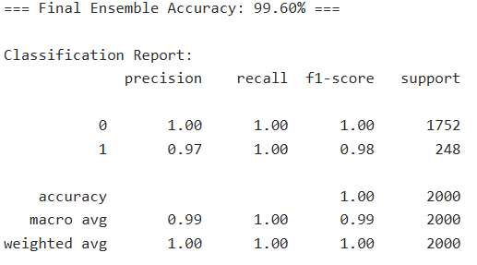
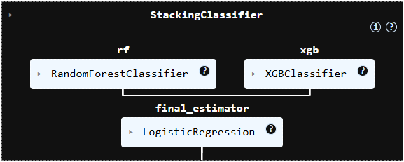
Machine Learning Model
The pre-processed dataset is divided into training, validation and testing sets for reliable model development.
A stacking ensemble model combines Random Forest and XGBoost as base learners.
Logistic Regression acts as the meta-classifier by integrating predictions from the base models.
The final model predicts flood occurrence and is evaluated using standard classification metrics for performance comparison.
Notes:
Speaker Notes
The machine learning framework uses a stacking ensemble approach to improve flood-risk prediction. Random Forest and XGBoost are trained as base learners to capture different patterns within the historical flood dataset. Their predictions are then combined using Logistic Regression as the meta-classifier, producing the final prediction. This ensemble strategy aims to improve robustness and predictive performance compared with individual models before evaluation using standard classification metrics.

Slide 10
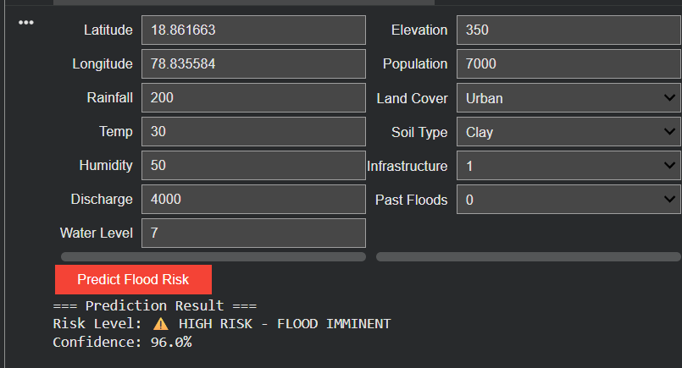
Flood Risk Prediction System
A user-friendly prediction interface accepts meteorological, hydrological and geographical input parameters.
The stacking ensemble model processes the input using Random Forest, XGBoost and Logistic Regression.
The system predicts flood occurrence with a confidence score based on learned patterns.
The prediction interface demonstrates the practical application of the developed machine learning framework for flood-risk assessment.
Notes:
Speaker Notes :
The developed prediction system allows users to enter environmental and hydrological parameters, including rainfall, water level, river discharge and land characteristics. These inputs are processed by the stacking ensemble model, which combines Random Forest, XGBoost and Logistic Regression to generate the final prediction. The interface displays both the predicted flood-risk level and a confidence score, demonstrating the practical application of the proposed machine learning framework.

Slide 11
Contributions
Designed a complete machine learning workflow for flood-risk prediction using historical rainfall and river observation data.
Implemented data preprocessing, feature encoding, scaling and dataset partitioning for reliable model training.
Developed classification models with hyperparameter tuning and performance evaluation using standard metrics.
Established a comparative framework to identify the most effective flood-risk prediction model under consistent experimental conditions.
Notes:
Speaker Notes:
The project contributes by developing a complete machine learning framework for flood-risk prediction using historical rainfall and river observation data. It includes systematic data preprocessing, feature preparation and implementation of multiple classification algorithms. Hyperparameter tuning and standard evaluation metrics are applied to ensure fair comparison between models. This framework supports identifying the most suitable prediction approach while providing a reproducible methodology for comparative flood-risk analysis and future research.

Slide 12
Conclusion & Future Work
The project has established a complete machine learning framework for flood-risk prediction using historical rainfall and river observation data.
Literature review, data preparation, preprocessing and model development have been successfully completed.
Initial prediction results demonstrate the feasibility of the proposed machine learning approach.
Future work will focus on model optimisation, comparative evaluation, result interpretation and dissertation completion.
Notes:
Speaker Notes
This project has successfully established the foundation for a machine learning-based flood-risk prediction system. The literature review, dataset preparation, preprocessing and model development have been completed according to the planned schedule. Initial prediction results demonstrate the feasibility of the proposed approach. The remaining work includes comprehensive model evaluation, comparative performance analysis, interpretation of findings and completion of the dissertation before the final project submission and assessment.

